Slide 1
Zivid One⁺
3D cameras

Slide 2
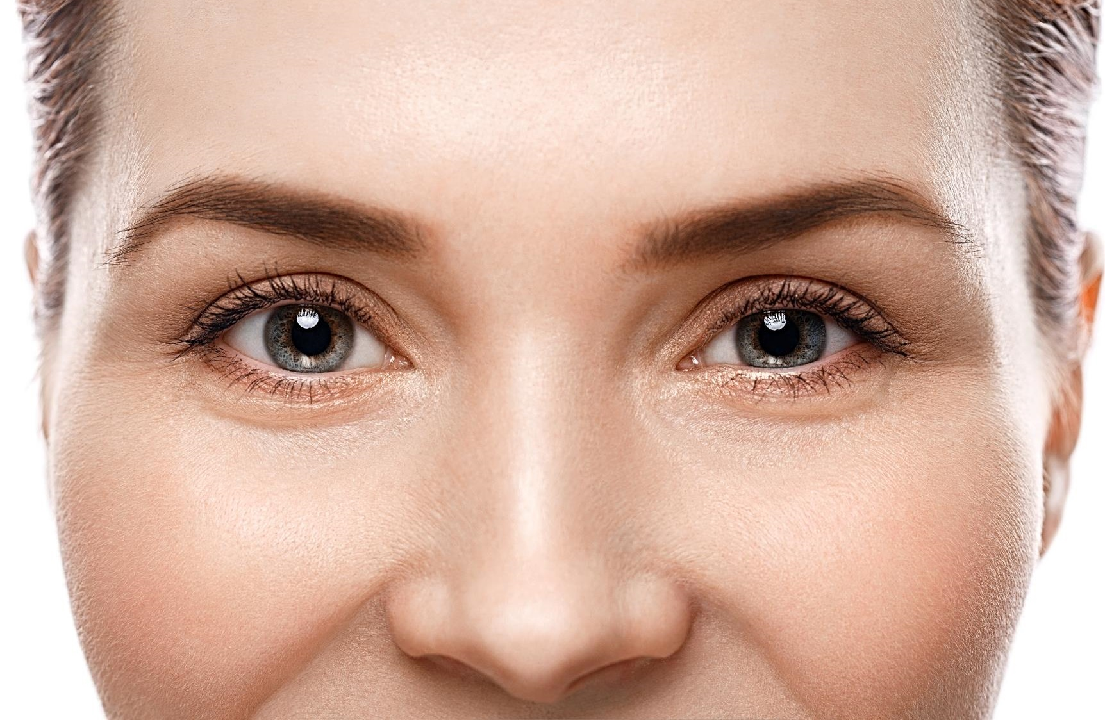
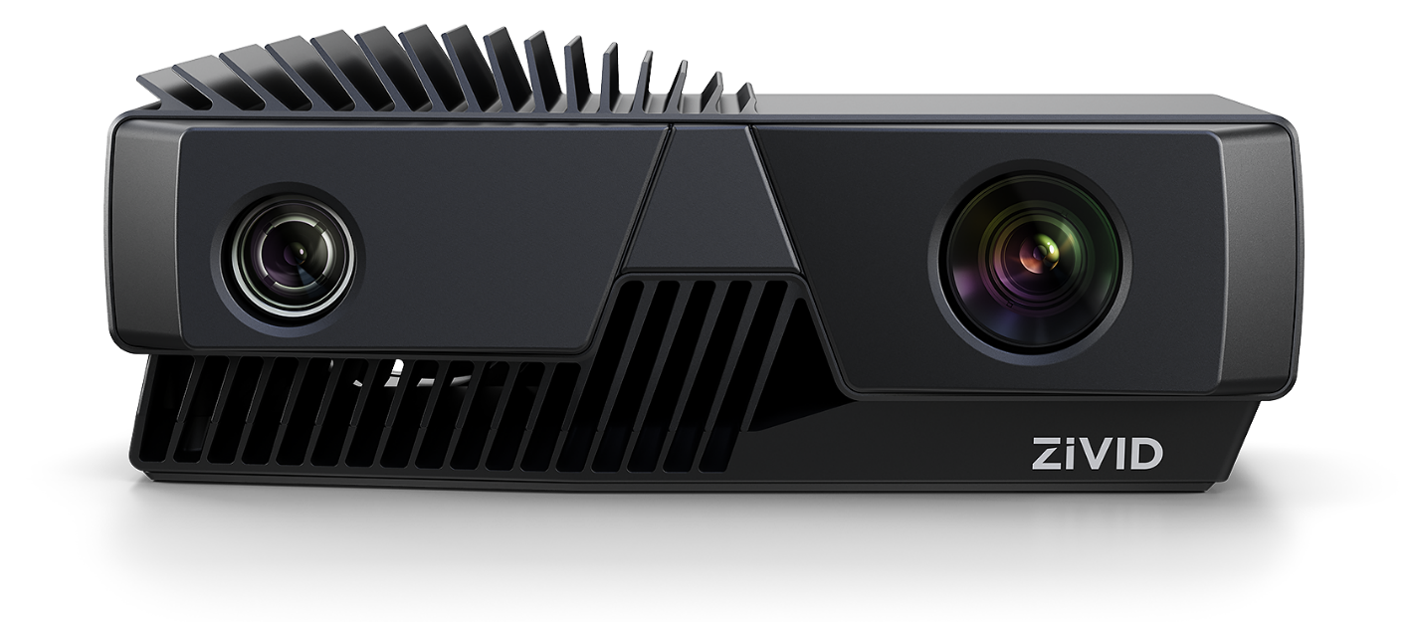
Our mission is human-like
vision for robots
Notes:
Robot- and industrial automation require human-like vision to operate in “our world”.

Slide 3
Our mission is human-like
vision for robots
Notes:
3D
Color
High dynamic range
Accurate

Slide 4
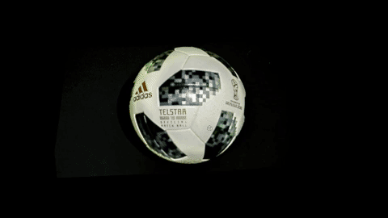
Zivid 3D vision technology
Time coded structured light 3D cameras
Details and colors
HD resolution
Native 3D RGB
30 cm to 3m
Working distance
High dynamic range
3D HDR
Fast
> 10 FPS burst
< 100ms acquisition time
Accurate
High precision and trueness

Slide 5
Zivid One⁺
Developer’s introduction

Slide 6
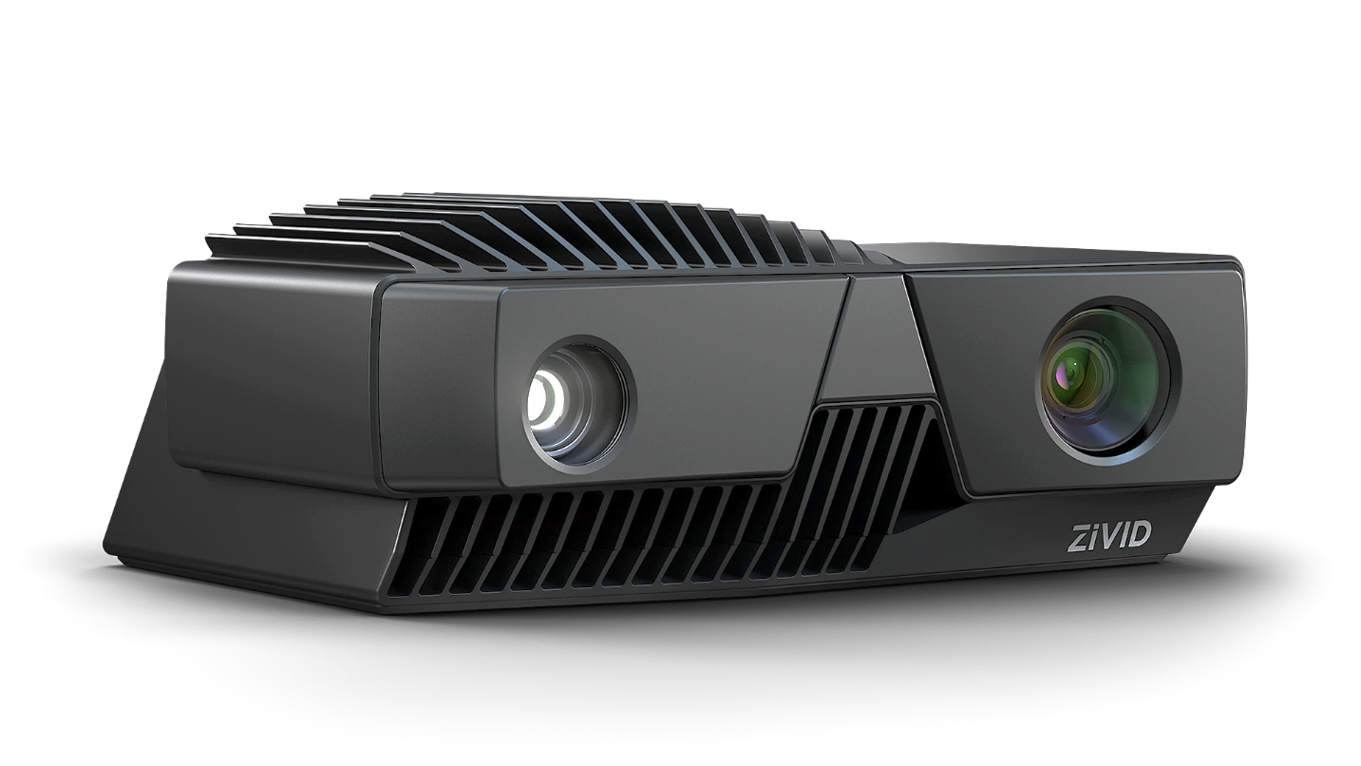
Zivid One⁺
Time coded structured light
3D camera
HD + Color
2.3 Megapixels
1920 x 1200 resolution
Native 3D RGB
Accurate
ZO+ Small: 25 µm point precision
ZO+ Medium: 60 µm point precision
ZO+ Large: 225 µm point precision
HDR
Extended dynamic range
Multi-frame 3D HDR merge
Fast
Up to 13 FPS burst
Down to 80 ms acquisition time
Notes:
Accuracy
Zivid One+ M at D = 600mm, La = 200 lux

Slide 7
Zivid One⁺
3D camera line-up
Model | S | M | L
Max distance | 1.0 m | 2.0 m | 3.0 m
Optimal working distance | 0.3 to 0.8 m | 0.6 to 1.6 m | 1.2 to 2.6 m
Key applications | Tiny to small objects Trays and boxes | Small to medium objects Totes and bins | Medium to large objects Standard EU/US pallets
Notes:
+ precision
+ key applications

Slide 8
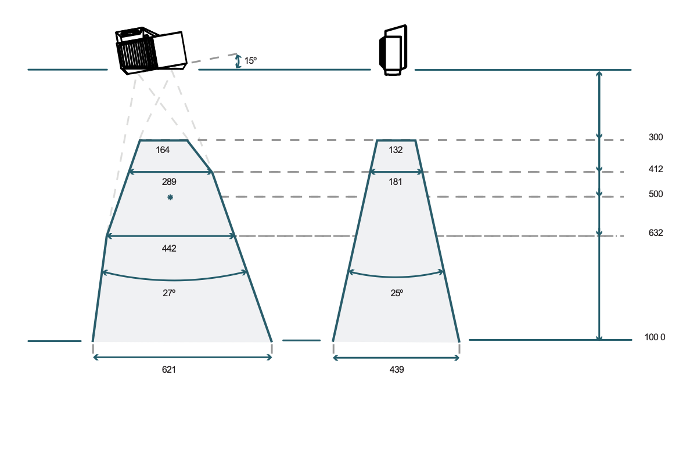
Zivid One⁺ S
Tiny to small objects – trays / boxes
Field of view
160 x 130 mm at 0.3 m (min distance)
620 x 440 mm at 1.0 m (max distance)
0.3 to 0.8 m optimal working distance
Full overlap between 0.45 to 0.6 m
Spatial resolution
0.12 mm at 0.3 m
0.32 mm at 0.8 m
0.40 mm at 1.0 m
Point precision
25 µm at 0.3 m
105 µm at 0.8 m
180 µm at 1.0 m

Slide 9
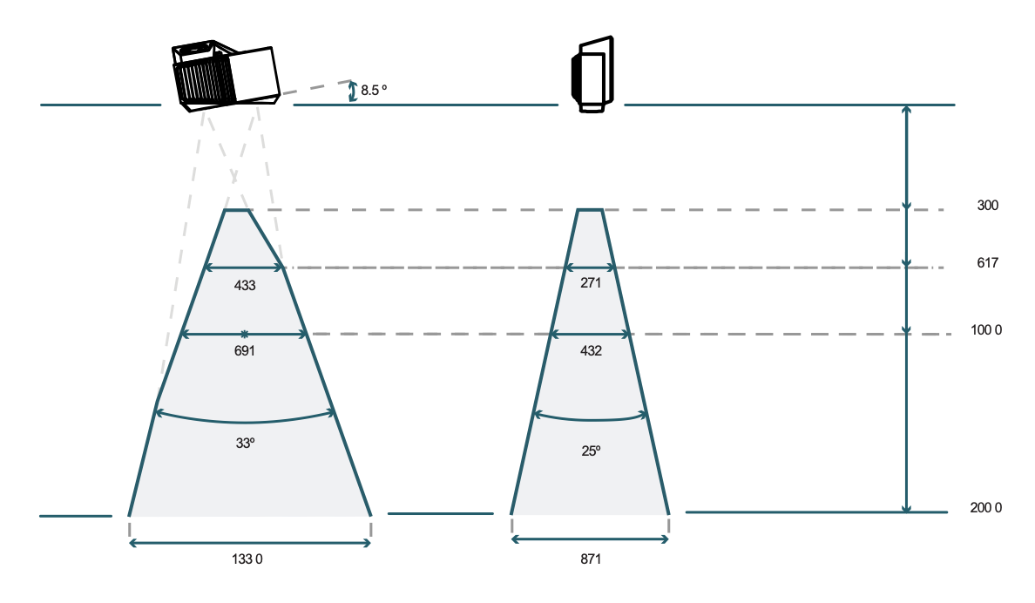
Zivid One⁺ M
Small to medium objects – totes / bins
Field of view
430 x 270 mm at 0.6 m (min distance)
1330 x 870 mm at 2.0 m (max distance)
0.6 to 1.6 m optimal working distance
Full overlap between 0.7 to 1.3 m
Spatial resolution
0.23 mm at 0.6 m
0.6 mm at 1.6 m
0.75 mm at 2.0 m
Point precision
60 µm at 0.6 m
570 µm at 1.6 m
900 µm at 2 m

Slide 10

Zivid One⁺ L
Medium to large objects – standard EU/US pallets
Field of view
843 x 530 mm at 1.2 m
2069 x 1310 mm at 3.0 m
1.2 to 2.6 m optimal working distance
Full overlap between 0.8 to 2.5 m
Spatial resolution
0.45 mm at 1.2 m
0.96 mm at 2.6 m
1.11 mm at 3.0 m
Point precision
225 µm at 1.2 m
1630 µm at 2.6 m
2500 µm at 3.0 m

Slide 11
Zivid One⁺
Exposure controls
Aperture |  | f/1.4 to f/32 | 9 stop range
Shutter |  | 1/154 to 1/10 s | 4 stop range
Gain |  | 1x to 16x | 4 stop range
Brightness |  | 1/8x to 1.8x | 4 stops range 400 lumens at 1x 720 lumens at 1.8x
Notes:
Aperture
Shutter speed
Imager gain (version v1.3)
Projection brightness

Slide 12
Zivid One⁺ speed
3D burst
2-frame 3D HDR burst
3-frame 3D HDR burst
5-frame 3D HDR burst
Up to 13 FPS
Up to 6 FPS
Up to 3 FPS
Up to 1 FPS
Notes:
Tac = 12 x Tshutter +

Slide 13

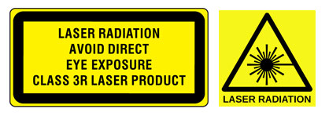
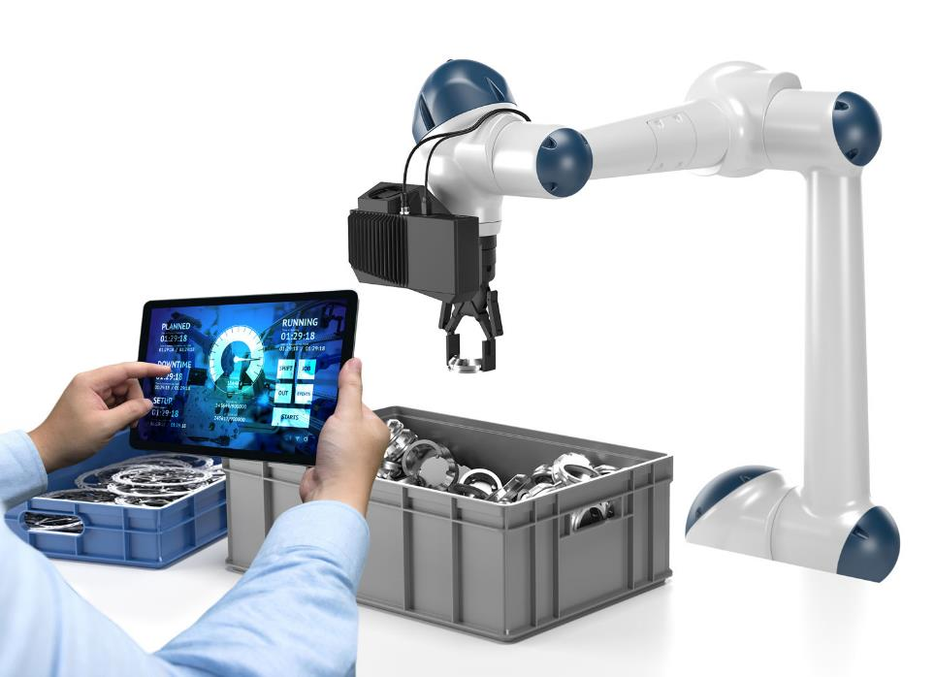
Non laser based Inherently safe for collaborative use
White light source Native color capabilities and broad material coverage Good data on most materials and surfaces Functional diversity and highly repurposable
Non laser based
Eye safe and less annoying No dangerous direct reflections from e.g. shiny objects No need for Laser Safety Officer or similar

Slide 14
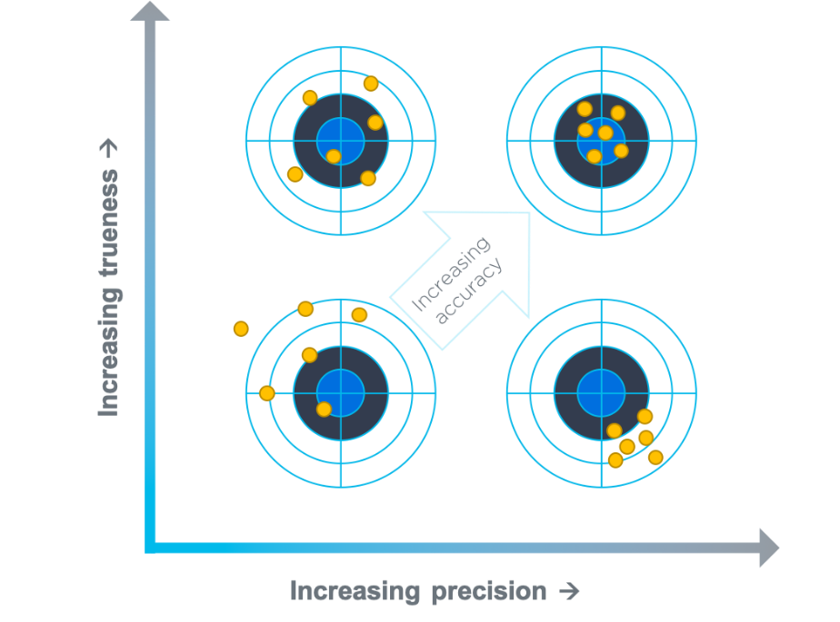
Understanding Zivid 3D camera accuracy
ISO 5725
Precision Describing random errors, a measure of statistical variability.
Trueness Describing systematic errors, a measure of statistical bias.
Accuracy Describing a the combination of random and systematic errors. Sum of Precision and Trueness.

Slide 15
ISO 5725 and 3D cameras
Precision, trueness and accuracy applied
Lower accuracy
Higher accuracy
Precision
random errors
TARGET SCENE
Trueness
deviation from true reference

Slide 16
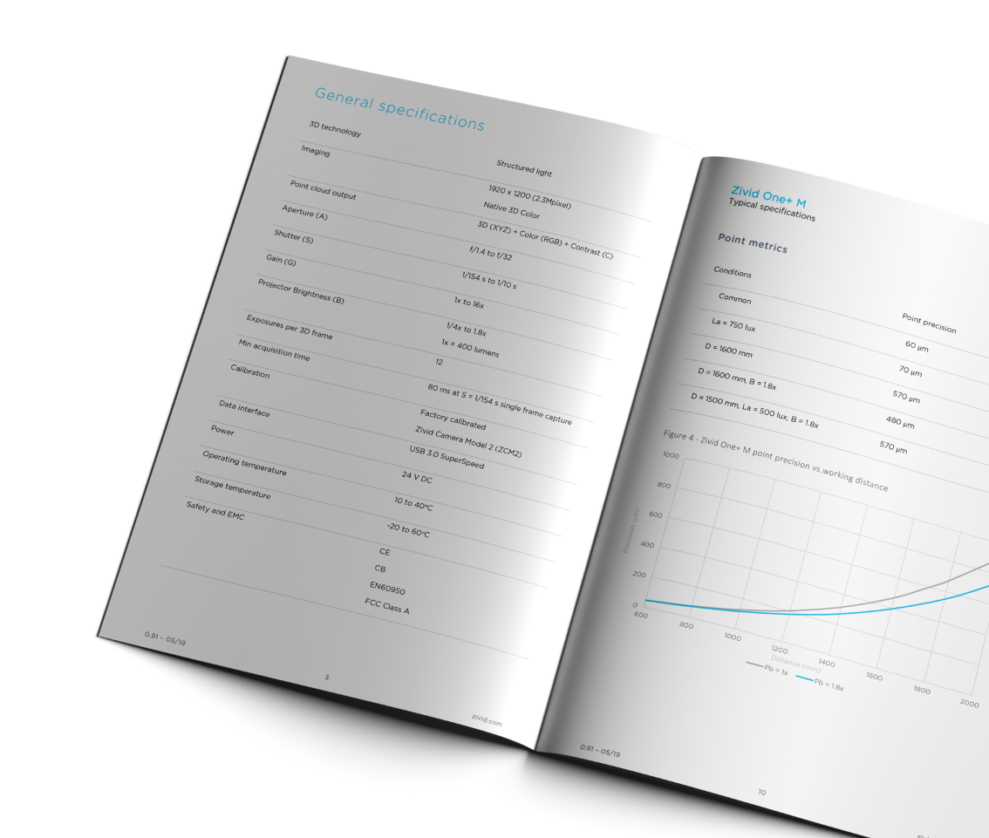
Datasheet specifications
Specifications
Point precision
Local planarity precision
Global planarity trueness and accuracy
Dimension precision, trueness and accuracy
Conditions
Working distance
Ambient temperature
Ambient light
Aperture
Imager Gain
Projector brightness

Slide 17
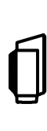
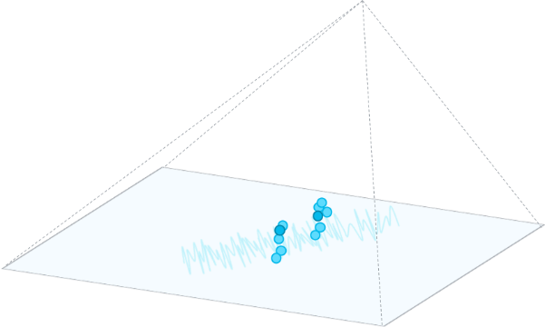
Point metrics
Zivid One+ M - typical specifications
Point precision | 60 | um
La = 750 lux | 70 | um
D = 1600mm | 570 | um
D = 1600mm, Pb = 1.8x | 480 | um
Conditions, unless otherwise specified:
Ambient temperature (Ta) = 25C Ambient light (La) = 200 lux Aperture (A) = f/5.6
Projector brightness (Pb) = 1x Imager gain (Ig) = 1x
Notes:
Incuding spatial resolution
One per model?

Slide 18
Point metrics
Zivid One+ M - typical specifications
Point precision vs. working distance
Conditions, unless otherwise specified:
Ambient temperature (Ta) = 25C Ambient light (La) = 200 lux Aperture (A) = f/5.6
Projector brightness (Pb) = 1x Imager gain (Ig) = 1x
Notes:
Incuding spatial resolution
One per model?

Slide 19
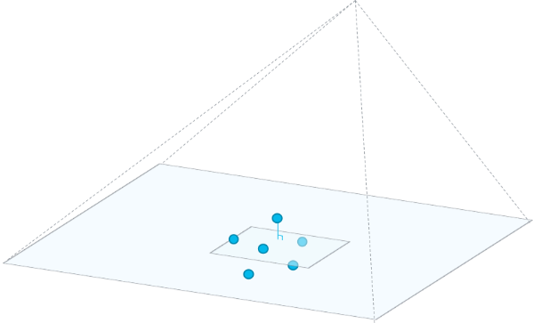
Global planarity metrics
Zivid One+ M - typical specifications
Global planarity trueness | 90 | um
D = 1600mm | 670 | um
D = 1600mm, Pb = 1.8x | 690 | um
Global planarity accuracy | 140 | um
D = 1600mm | 1030 | um
D = 1600mm, Pb = 1.8x | 1000 | um
Global
Conditions, unless otherwise specified:
Ambient temperature (Ta) = 25C Ambient light (La) = 200 lux Aperture (A) = f/5.6
Projector brightness (Pb) = 1x Imager gain (Ig) = 1x
Notes:
Incuding spatial resolution
One per model?

Slide 20
Zivid One+ M
Point metrics – typical specifications
Point precision | 60 | um
La = 750 lux | 70 | um
D = 1600mm | 570 | um
D = 1600mm, Pb = 1.8x | 480 | um
D = 1500mm, La = 500 lux, Pb = 1.8x | 570 | um
Conditions, unless otherwise specified:
Ambient temperature (Ta) = 25C Ambient light (La) = 200 lux Aperture (A) = f/5.6 Distance (D) = 600mm
Projector brightness (Pb) = 1x Imager gain (Ig) = 1x
Notes:
Incuding spatial resolution
One per model?

Slide 21

Zivid One+ M
Local planarity metrics – typical specifications
Local planarity precision | 90 | um
La = 750 lux | 100 | um
D = 1600mm | 610 | um
D = 1600mm, Pb = 1.8x | 540 | um
D = 1500mm, La = 500 lux, Pb = 1.8x | 630 | um
Conditions, unless otherwise specified:
Ambient temperature (Ta) = 25C Ambient light (La) = 200 lux Aperture (A) = f/5.6 Distance (D) = 600mm
Projector brightness (Pb) = 1x Imager gain (Ig) = 1x
Local
Notes:
Incuding spatial resolution
One per model?

Slide 22
Zivid One+ M
Global planarity metrics – typical specifications
Global planarity trueness | 90 | um
D = 1600mm | 670 | um
D = 1600mm, Pb = 1.8x | 690 | um
Global planarity accuracy | 140 | um
D = 1600mm | 1030 | um
D = 1600mm, Pb = 1.8x | 1000 | um
Global
Conditions, unless otherwise specified:
Ambient temperature (Ta) = 25C Ambient light (La) = 200 lux Aperture (A) = f/5.6 Distance (D) = 600mm
Projector brightness (Pb) = 1x Imager gain (Ig) = 1x
Notes:
Incuding spatial resolution
One per model?

Slide 23
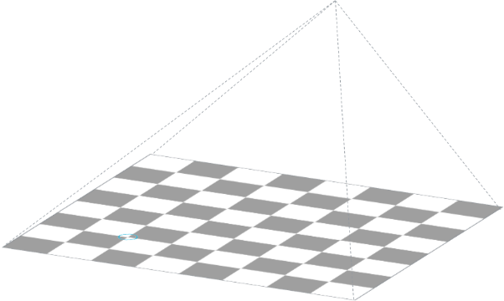
Zivid One+ M
Dimension metrics – typical specifications
Dimension precision | 170 | um
D = 1600mm | 380 | um
Dimension trueness | < 1.0 | %
Dimension accuracy | < 1.0 | %
Conditions, unless otherwise specified:
Ambient temperature (Ta) = 25C Ambient light (La) = 200 lux Aperture (A) = f/5.6 Distance (D) = 600mm
Projector brightness (Pb) = 1x Imager gain (Ig) = 1x
Notes:
Measuing 5x 20mm squares

Slide 24
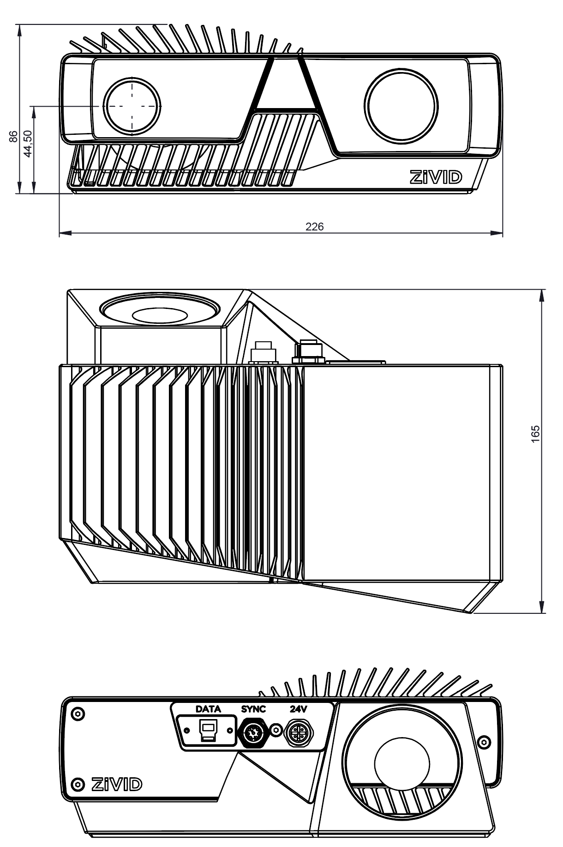
Zivid One+
Industry ready design
Rugged design | Aluminum body IP65 water and dust 5G Random (10-55Hz) 15G Shock
Size and weight | 226x86x165mm 1980g
Data and power | USB 3.0 SuperSpeed type-B 24V 5A DC
Certifications | CE FCC Class A
Operating conditions | 10 to 40C
Notes:
3x reference scenes with settings

Slide 25
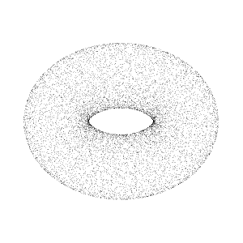
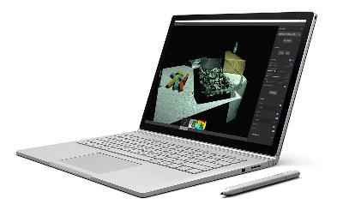
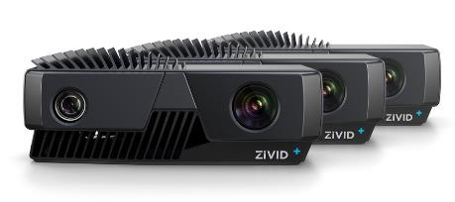
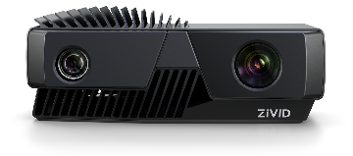
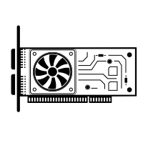
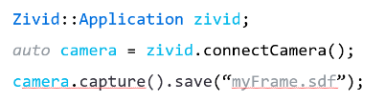
The Zivid One⁺ solution
Zivid One⁺ | Zivid Studio | Zivid SDK
Award winning 3D color cameras [S/M/L] High performance & industrial grade. | Explore, evaluate and learn. A highly modern UI for point cloud capturing with Zivid 3D color cameras | The essential tool suite for machine vision software development, cross-platform and GPU accelerated.
Notes:
Zivid provides
Zivid One 3D color camera
Zivid API - drivers that produce a hi-res point cloud with color info
Zivid Studio – GUI to view, measure and optimize settings

Slide 26
Zivid Studio
The easy to use application for
Point cloud capture
and exploration
Capture high-quality 3D point clouds Single or multi-frame HDR. Manual or automatic with Capture Assistant
View captured 3D data Explore 3D data, 2D depth map or corresponding 2D color image.
Controls and filters Configure settings and filters per frame, and combine frames for 3D HDR. Use Histogram feature to get the best exposures per capture.
Explore sample scenes at
zivid.com/images

Slide 27
Zivid SDK
The essential tool suite for
developing machine vision software with Zivid 3D cameras
Example Applications
Tools & Utilities
Libraries
Cross platform
x86-64
Linux and Windows
Language & wrappers
Native: C++ / .NET
Wrappers: Genicam
Core API
Core
ZVE 2
Zivid Vision Engine
Camera
Control
Zivid Vision Engine
GPU accelerated point cloud computations
Hardware drivers
Simplified block diagram

Slide 28
Getting Started
Quick Start Guide | zivid.com/start
Zivid One+ datasheet | zivid.com/downloads
Point cloud examples | zivid.com/images
Free 1:1 online demo | zivid.com/schedule-a-free-zivid-demo
Developer kits | zivid.com/order

Slide 29
Learn more at www.zivid.com
Human-like vision for robots

